Slide 1
Manual
Communication activities for Assosport members
Connecting Global Competence

Slide 2
Activities overview
1. Brand activities
1.1 ISPO.com logo and linking
1.2 Social Media
1.3 Social Buzz
1.4 Editorial report
1.5 Newsletter integration
2. Visitor communication activities
2.1 ISPO MUNICH logo and linking
2.2 Invitation of customers
2.3 Print-Advertisement
According to the cooperation agreement between Assosport and ISPO/Messe München members have to fulfill and proof 3 of the activities described in this document in order to receive full remuneration.

Slide 3
1. Brand Activities

Slide 4
1.1 ISPO.com Logo and Linking
- Activity:
ISPO.com „logo“ (News for Sports Experts) + linking to www.ispo.com
The link has to be on the 1st or 2nd level on the homepage 2nd level means, max. 1 click below the mainlevel
- Reference:
Example: Fair - Bauma

Slide 5
1.1 Proof-Example
- Screenshot + active URL, on which the logo is integrated
URL:
http://www.cat.com/de_DE/ campaigns/event/
bauma-2016.html

Slide 6
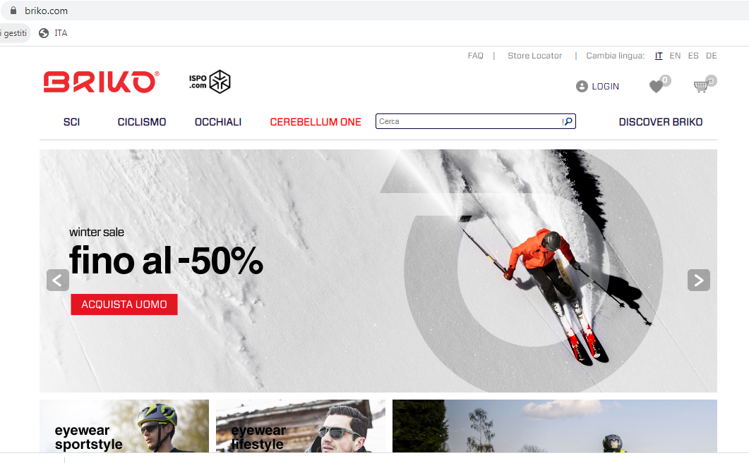
1.1 Proof
- Screenshot + active URL, on which the logo is integrated
URL:
https://www.briko.com/

Slide 7
1.2 Social Media Range
Activity:
Opportunities:
An article on one of the social media channels (Facebook, LinkedIn)
sharing of ISPO.com articles; sharing of ISPO Facebook posts / ISPO LinkedIn posts
range minimum of 5.000 persons reached per article
- Reference:

Slide 8
1.2 Proof-Example
- Screenshots of the published posts incl. reach data within the range evidence

Slide 9
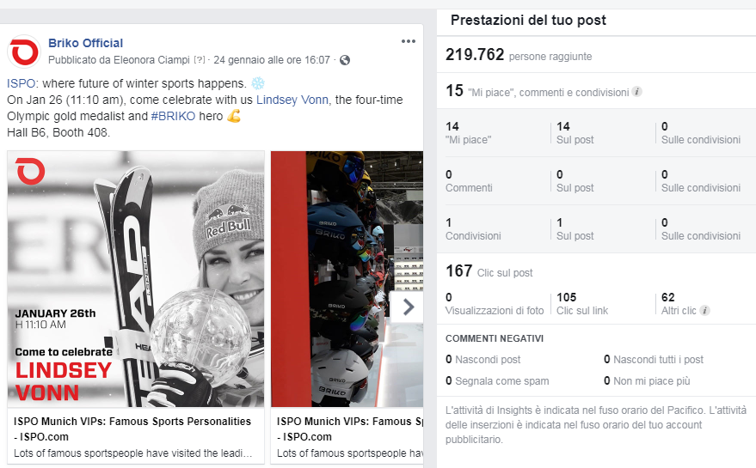
1.2 Proof
- Screenshots of the published posts incl. reach data within the range evidence

Slide 10
1.4 Editorial Report
- Activity: An editorial report on your online presence (blog) with linking to ISPO.com

Slide 11
1.4 Proof-Example
- active URL + screenshot
URL:
www.wiwo.de/technologie/gadgets/ ispo-2016-die-spannendsten-neuheiten
-der-sport-messe/12838398.html

Slide 12
1.4 Proof
- active URL + screenshot
URL:
http://www.basicpress.com/contenuti/media/resultMedia.asp?ID=149454&hilight=149454

Slide 13
2. Visitor communication activities

Slide 14
2.2 Invitation of customers (Print and Digital)
- Activity:
The ISPO MUNICH logo has to be integrated in the invitation. Timing: before the respective show starts.
Frequency and outreach according to the companies capability
- Reference:

Slide 15
2.2 Proof-Example
Scan or screenshot of the invitation
Mailing: Fallback-Link = URL of the invitation (invitation can be opened in the browser)
Fallback-Link:
URL:
http://fairsltd.us11.list- manage.com/track/click?u=16f0615e606aa 79ccc726e043&id=866151ad4a&e=2b242ef b79
(Attention: This example fallback-link is no longer active, but only an explanatory note)

Slide 16
2.2 Proof
Scan or screenshot of the invitation
Mailing: Fallback-Link = URL of the invitation (invitation can be opened in the browser)
Fallback-Link:
URL:
Please insert here...

